Slide 1

Federated Learning of Gboard
Language Models with Differential Privacy
Zheng Xu
Presenting the work of many

Slide 2
Machine Learning from User Data
Privacy-preserving
training
deployment
development
engineer
Notes:
To train a machine learning model

Slide 3

Cross-device Federated Learning
admin
server
client
devices
federated training
model
development
model
deployment
engineer

Slide 4

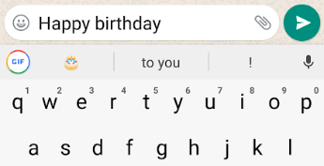

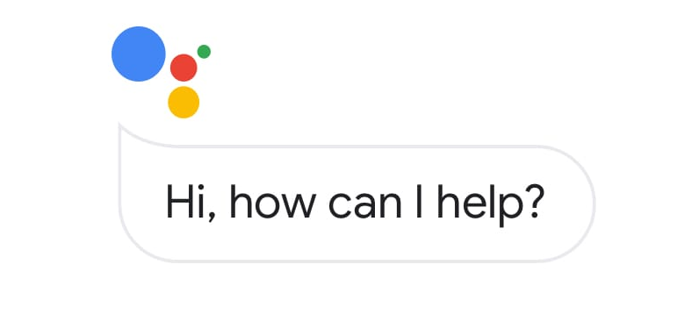
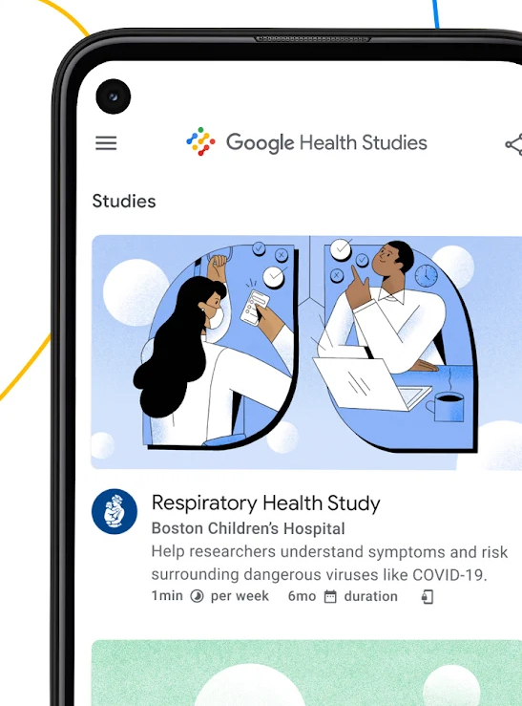

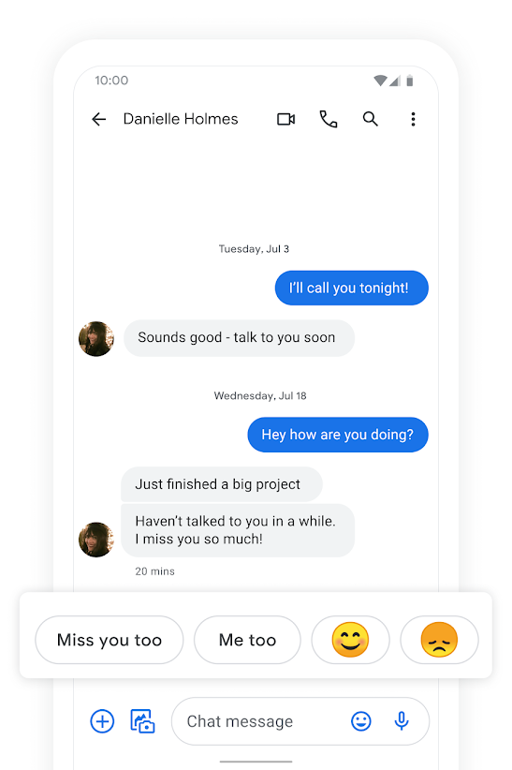
Gboard
FL & FA at Google
emoji and sticker prediction
next word prediction
Android smart text selection
Federated learning and analytics are deployed in an increasing array of apps and services.
new vocabulary discovery
Google Health Studies
"Hey Google" hotword detection
Respiratory health study
Android Messages
Notes:
Image sources:
https://play.google.com/store/apps/details?id=com.google.android.apps.messaging&hl=en_US&gl=US
https://play.google.com/store/apps/details?id=com.google.android.apps.health.research.studies&hl=en_US&gl=US
https://ai.googleblog.com/2018/08/the-machine-learning-behind-android.html
https://www.android.com/
https://security.googleblog.com/2020/10/privacy-preserving-smart-input-with.html

Slide 5
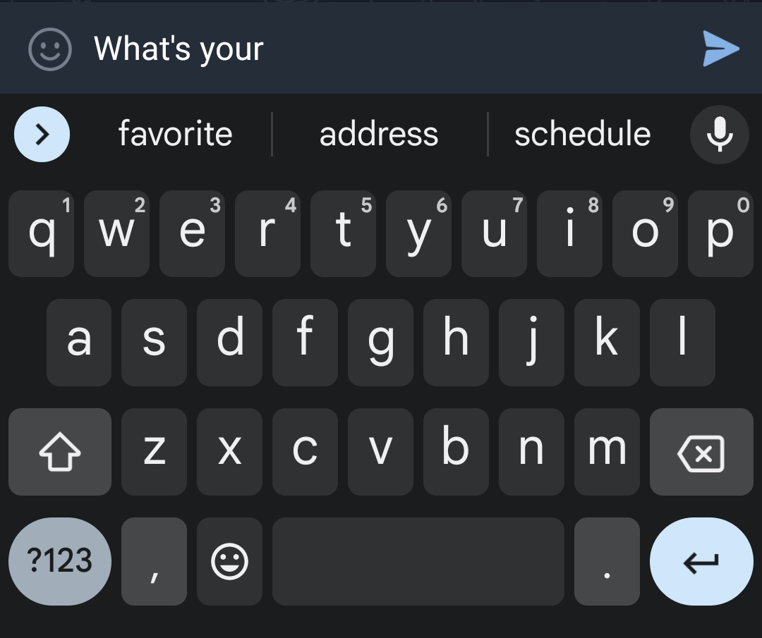
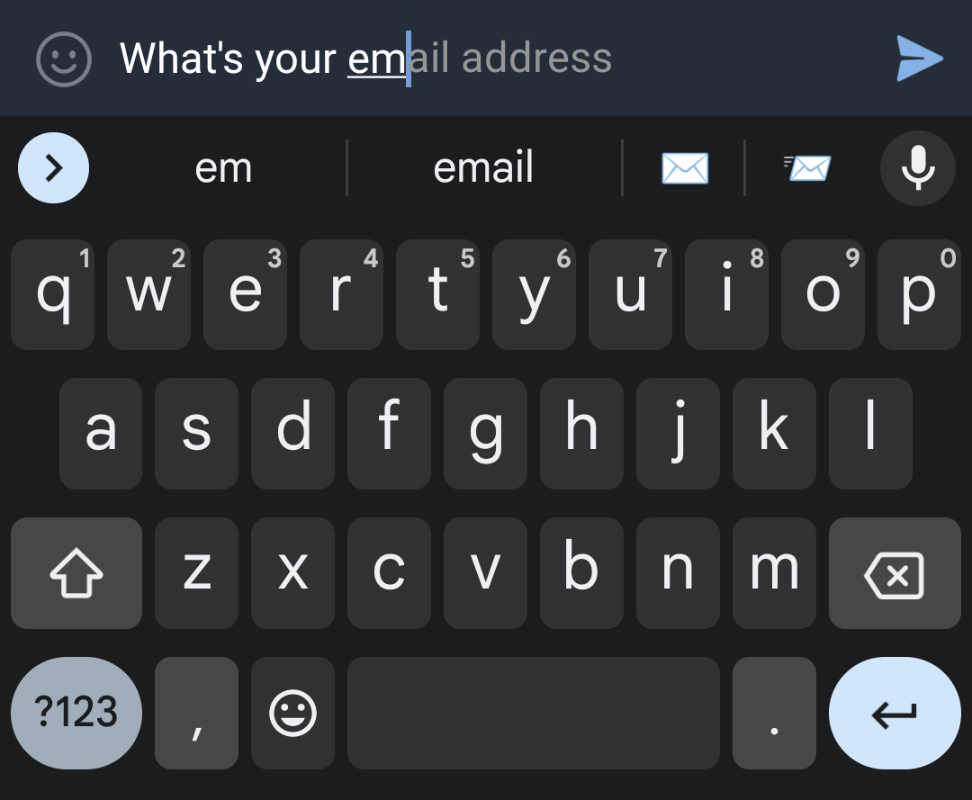
Gboard Language Models (LMs)
One-layer LSTM
Gboard Next Word Prediction (NWP)
Smart Compose (SC)
On-The-Fly Rescoring(OTF)
NWP LM: ~2.4M / 4.4M parameters
OTF LM: ~6.4M parameters

Slide 6
Privacy Principles
Transparency and User control
Users can be aware of what data is used, what purpose it is used or and how it is processed, and have full control on whether to enable the collection and use of their data
Data minimization
Data is only collected focusing on specific computation needs, with access limited at all data processing stages
Data anonymization
The final released output of the computation does not reveal anything unique to an individual
Auditability and verifiability
Users, and potentially third parties can audit and verify privacy claims by examining released models, open-sourced code, and privitarized system logs, etc.
Federated Learning and Privacy 2022
Private Federated Learning in Gboard 2023

Slide 7
Privacy Principles in Gboard
Transparency and User control
Users can be aware of what data is used, what purpose it is used or and how it is processed, and have full control on whether to enable the collection and use of their data
Users can turn off learning at any time
Data minimization
Data is only collected focusing on specific computation needs, with access limited at all data processing stages
Federated Learning (and Secure Aggregation)
Data anonymization
The final released output of the computation does not reveal anything unique to an individual
Differential Privacy
Auditability and verifiability
Users, and potentially third parties can audit and verify privacy claims by examining released models, open-sourced code, and privitarized system logs, etc.
Federated Learning and Privacy 2022
Private Federated Learning in Gboard 2023

Slide 8
Journey of (Differential) Privacy for Gboard NWP
Federated Learning (FL)
Tier 1.5: Towards strong formal privacy guarantees; ε < 1?
Gboard Next Word Prediction (NWP)
2023+ stronger DP guarantees for all neural models, with possibly additional Trusted Aggregation; all future LMs require DP to be launched
Tier 2: Realistic privacy guarantees; ε < 10
2022 Meaningful differential privacy (DP) guarantee for the spanish model. First production neural network trained directly on user data announced with DP.
2020 Clipping and adding noise to prevent memorization. Launched and empirically audited for spanish model in spain.
Tier 3: Weak to no formal privacy guarantees; finite eps with empirical auditing
Section 5.2.2 Target ε guidelines for ML models,
How to DP-fy ML: A Practical Guide to Machine Learning with Differential Privacy

Slide 9
Basic Federated Learning
3. Local training
Population of client devices
1. A subset of clients can participate in a training round when local criteria are met
∑
4. Aggregate updates from at least report goal number of clients
5. Apply update to model
2. Broadcast model
6. Launch final model after all training rounds
0. (Random) model initialization

Slide 10

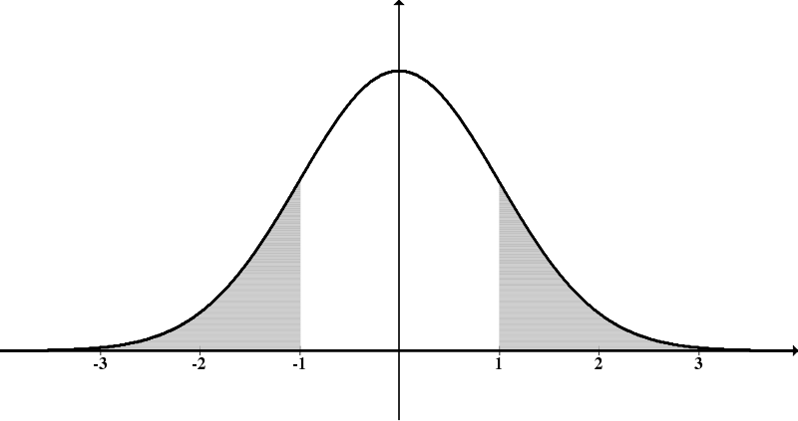
Private Federated Learning
3. Clip after local training to limit a user’s contribution
Population of client devices
1. A subset of clients can participate in a training round when local criteria are met; client participation control is applied
∑
+
4. (Securely) aggregate
updates from at least report goal number of clients
5. Add stateful noise
DP release
6. Apply privatized update to model
2. Broadcast model
7. Launch final model after all training rounds
0. (Optional) initialize model with public pre-training

Slide 11
Algorithm System Co-design
DP-SGD DP-FTRL
Training Round
Model update / gradient
Mech.
Output
Model update / gradient
Mech.
Output
1
⊕
Gaussian Mech
g₁
⊕
Stateful
Differential Privacy (DP)
Mechanism
g₁
2
⊕
Gaussian Mech
g₂
⊕
g₁ + g₂
⊕
g₁ + g₂+ g₃
3
⊕
Gaussian Mech
g₃
⊕
g₁ + g₂+ g₃ + g₄
4
⊕
Gaussian Mech
g₄
Practical and Private (Deep) Learning without Sampling or Shuffling 2021 https://arxiv.org/abs/2103.00039
Notes:
A stateful mechanism can provide advantages similar to sampling --- the output on a round might be influenced by any of the previous batches, not just the most recent one.
On round 4, the mechanism can reveal a little more information about g₁, g₂, g₃ by cancelling out noise added earlier, "mixed together" with a noise estimate of g₄.

Slide 12
New (Best) Practices
Pre-train the model with public data (C4)
Choose the maximum noise multiplier that meets the utility target based on small scale simulation experiments on public datasets that is similar to the production task
Linearly increase the report goal and noise multiplier to meet the privacy target, and choose a large report goal supported by the system and population dynamics.
Estimate the possible maximum min separation based on chosen report goal and estimated population, and configure the client timer period to approach the desired min separation
DP-FTRL training with hyperparameters
Apply DP-FTRL with adaptive clipping without manual tuning to try meet the privacy and utility goals
For reliable optimization and stronger privacy-utility trade-offs, run DP-FTRL with adaptive clipping once to estimate clipping norm and then fix it
Federated Learning of Gboard Language Models with Differential Privacy 2023 https://arxiv.org/abs/2305.18465

Slide 13
Application in Production Gboard Language Models: Utility
Strong utility in A/B testing
Better than N-Gram base models
Comparable with no-DP neural models (strong baselines)
Scale through computation is the key to achieve strong privacy-utility trade-off
6500 client devices per round
Federated Learning of Gboard Language Models with Differential Privacy 2023 https://arxiv.org/abs/2305.18465

Slide 14
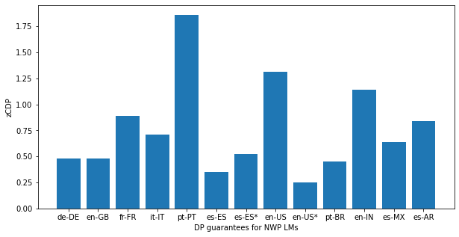
Application in Production Gboard Language Models: DP
2.6-zCDP,
US Census Bureau
alternatively,
(ε=13.69, δ=10-¹⁰)-DP
alternatively,
(ε=4.49, δ=10⁻¹⁰)-DP
Federated Learning of Gboard Language Models with Differential Privacy 2023 https://arxiv.org/abs/2305.18465

Slide 15
Reporting DP guarantees
DP setting: central DP with honest but curious server
DP definition:
Data accesses covered: The DP guarantee applies to all well-behaved clients in a single training run. We do not account for hyperparameter tuning, or the selection of the final model checkpoint using evaluation metrics or A/B testing in our guarantees. Public multilingual C4 data is used for pre-training.
Final mechanism output: Only the final model checkpoint is released for production launches, however all intermediate models are protected (including those sent to devices participating in federated learning).
Unit of privacy: Device-level DP; the device might have an arbitrarily large local dataset containing arbitrary training examples. For user’s with a single device, this corresponds directly to user-level DP.
Adjacency definition for “neigbouring” datasets: zero-out; in the absence of a client at any training step, we assume that the client’s model update gets replaced with the all zeros vector.
Privacy accounting details
Type of accounting: ρ−zCDP and (ϵ, δ)−DP
Accounting assumptions: there are at least a min-separation number of rounds between two consecutive participation of a client that is enforced by a timer on clients in the cross-device FL system
The formal DP statement: ρ−zCDP range in (0.2, 2), corresponding ϵ for (ϵ, δ)−DP in (4, 14) when δ = 10⁻¹⁰
Transparency and verifiability: open-source code
Section 5.3 Target ε guidelines for ML models,
How to DP-fy ML: A Practical Guide to Machine Learning with Differential Privacy

Slide 16
Open-source Code for DP FL
TFF aggregator https://github.com/tensorflow/federated/blob/main/tensorflow_federated/python/aggregators/differential_privacy.py
TFP DPQuery https://github.com/tensorflow/privacy/blob/master/tensorflow_privacy/privacy/dp_query/tree_aggregation_query.py
DP accounting https://github.com/google-research/federated/blob/master/dp_ftrl/blogpost_supplemental_privacy_accounting.ipynb
FL system https://github.com/google/federated-compute
Federated Learning of Gboard Language Models with Differential Privacy 2023 https://arxiv.org/abs/2305.18465

Slide 17
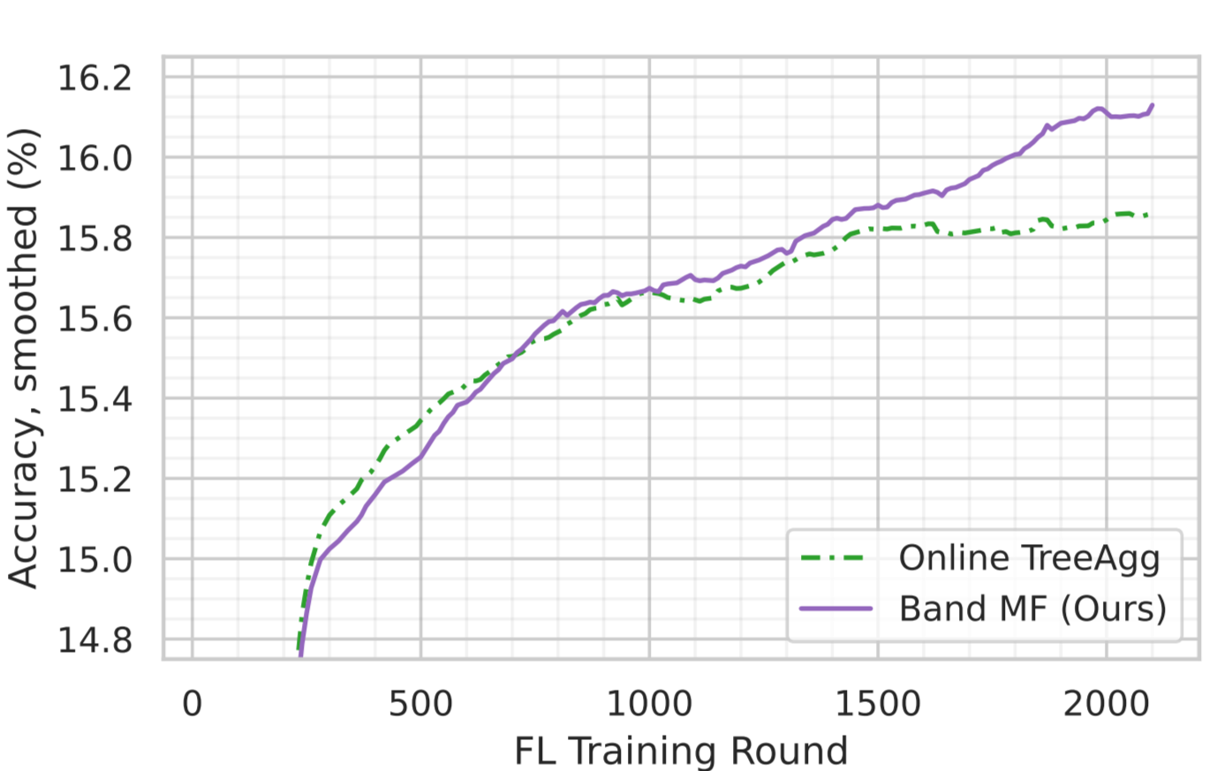
Can we do even better?
User-level DP
Gboard Spanish LM
(ε=4.35, δ=10⁻¹⁰)-DP
(ε=6.69, δ=10⁻¹⁰)-DP
(Amplified) Banded Matrix Factorization: A unified approach to private training 2023 https://arxiv.org/abs/2306.08153

Slide 18
Takeaways
Thank you!
(Differential) privacy is achievable in practice
Through system algorithm co-design
Scale is the key: large amount of data and computation resources
Improving privacy-utility trade-off by public data, new algorithms, DP mechanism and accounting
Privacy is not “free”
Computation and infrastructure support
Common understanding of the techniques: verifiable, auditing
Engineering efforts / migration cost

